Slide 1


Graduating Class Job Interviews

Slide 2
Part 1: Job Search Planning & Preparation
I have:
-a clear understanding of the job search process and have developed a job-search strategy.
-a clear understanding of the jobs which interest me - and which I am qualified for.
-outlined a clear career path/track for myself.
-identified my strengths and weaknesses.
-developed my unique selling proposition, which will help me distinguish myself from other
job seekers.
-identified my key accomplishments from all school and work experiences.
-identified my core transferable skills.
-identified the main industries/companies which interest me.
-researched the companies which most interest me.
-a clear understanding of the importance of marketing skills when job-hunting.
-gathered a key list (including contact information) of references.

Slide 3

Common Interview Questions
You will probably be asked questions to find out whether or not you have the skills/experience to do
the job, therefore make sure you can answer questions relating to the job specifics. The
advertisement itself is an appropriate place to work out what they are likely to ask you regarding your
professional abilities. You will probably also be asked some general questions, so that they can find
out more about you, your future plans and so on. Expect questions like ‘tell me about yourself' (an
opportunity to present your particular strengths for the job), ‘what are you weaknesses' (an opportunity
to show how you have learned useful lessons) or ‘where do you want to be in the next X years' (allows
you to show ambition and company loyalty).
These are common, general questions you should prepare to answer:
Tell me about yourself
What motivates you?/Why do you want this job?
What are your strengths/weaknesses
Where would you like to be in the next three/five years?
What did you like the most/least about your last job?
-Prepare yourself - know your CV; this sounds obvious, yet when you are nervous and concentrating
on impressing the interviewer, you can often forget the key points on your CV. The more you have
gone through your achievements and work experience, the better you will be able to communicate
these.
-Try and relax - this will allow you to be more natural and the more you will smile and engage better
with your interviewer.
-Mirror the style of the interviewer - this will allow you to build rapport more easily and will lead
again to a more natural conversation where you are likely to perform and communicate with a higher
degree of ease.

Slide 4
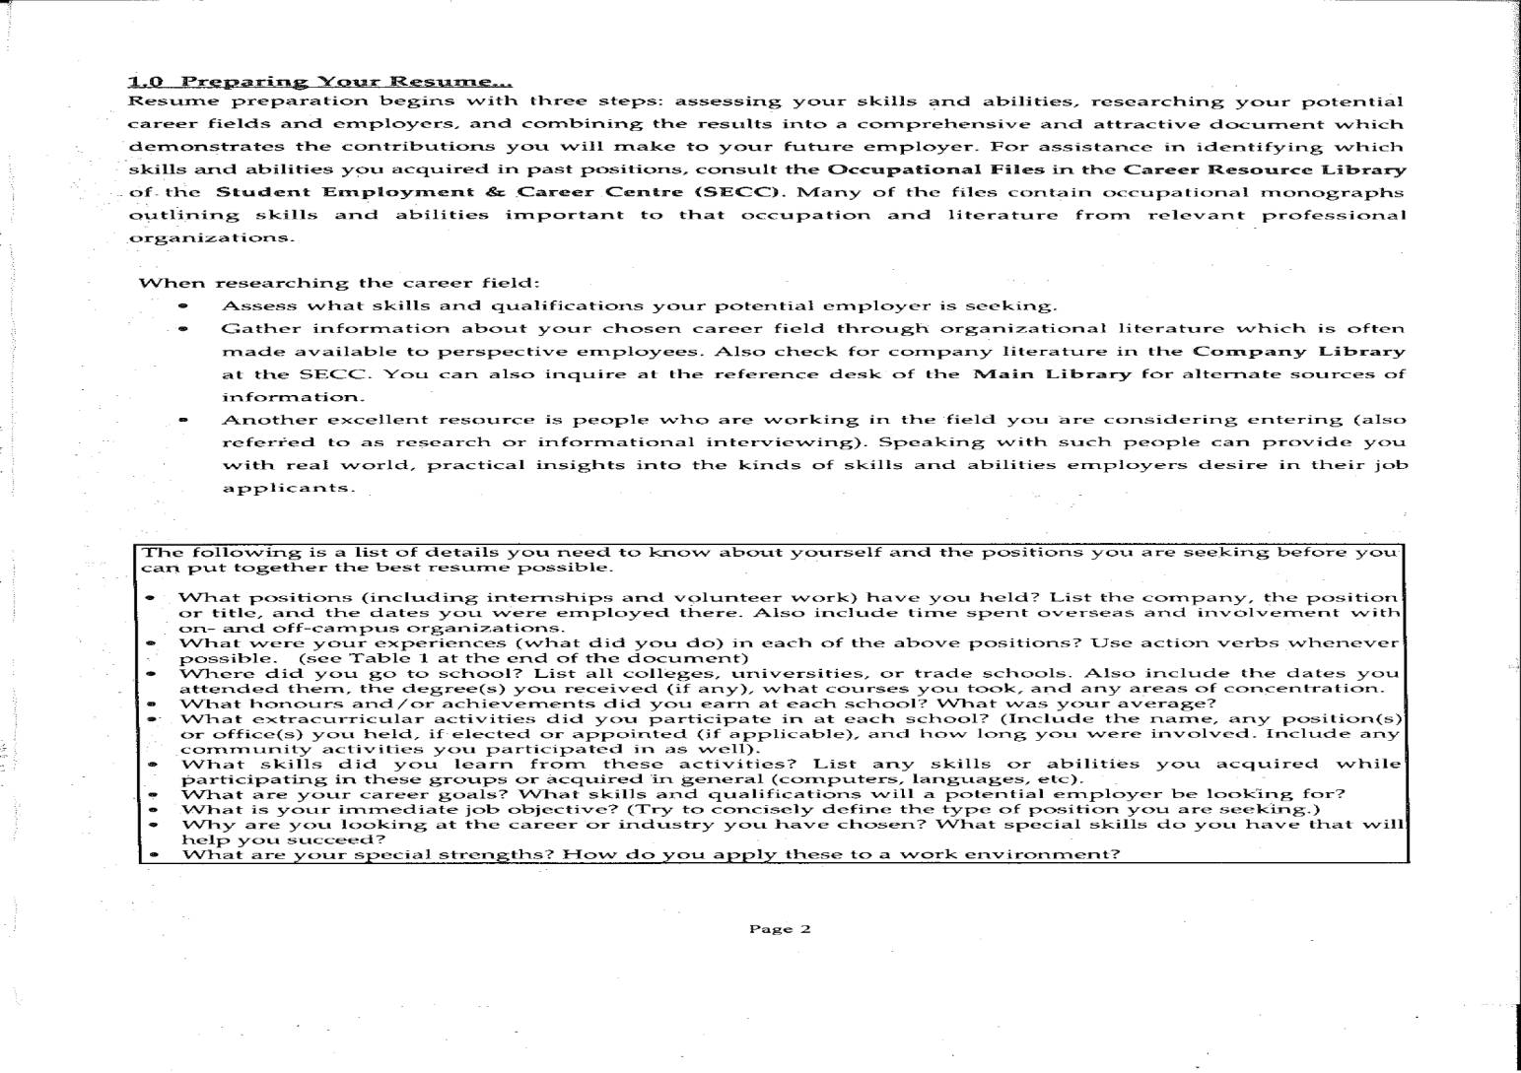
Bear the following in mind:

Slide 5
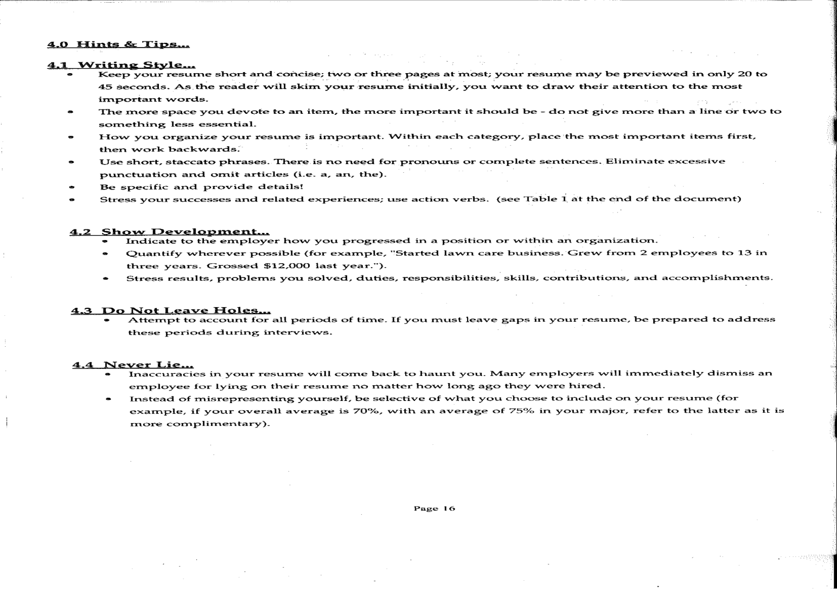

Slide 6
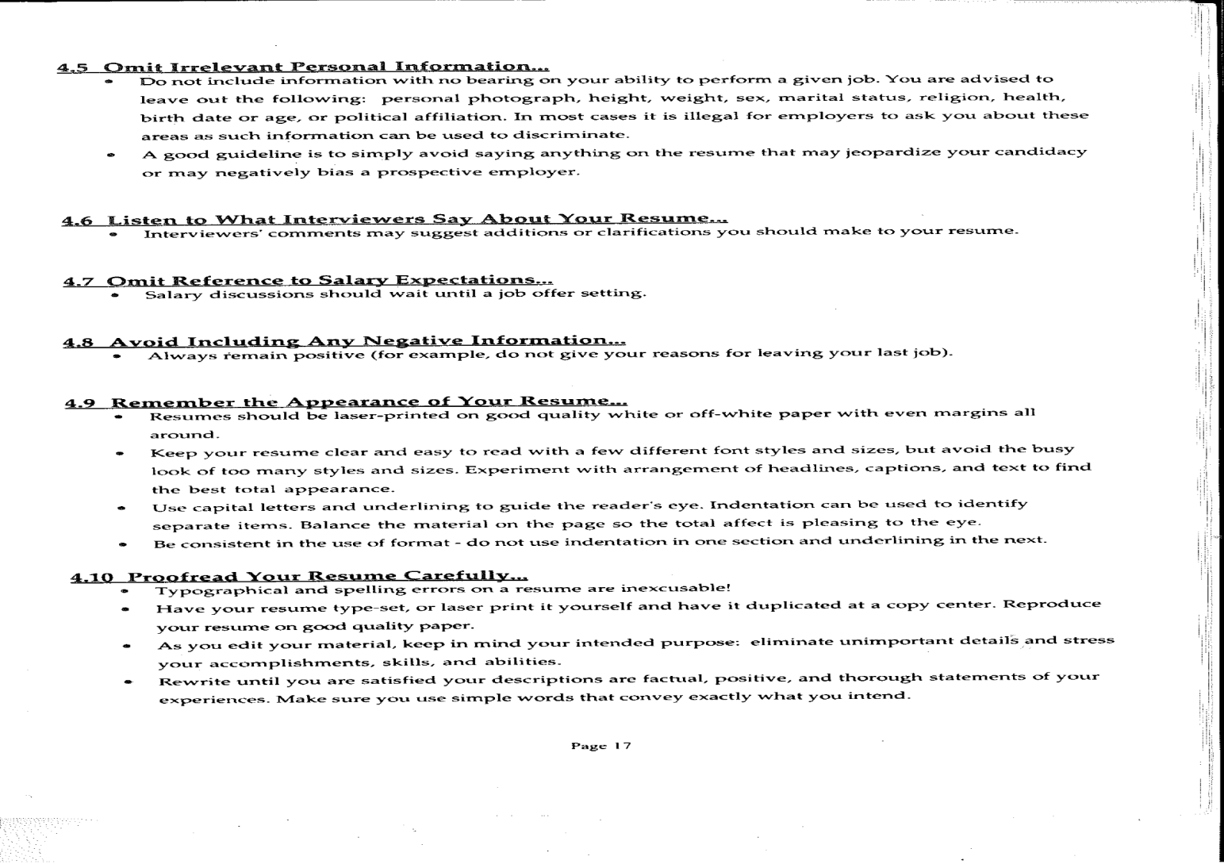

Slide 7
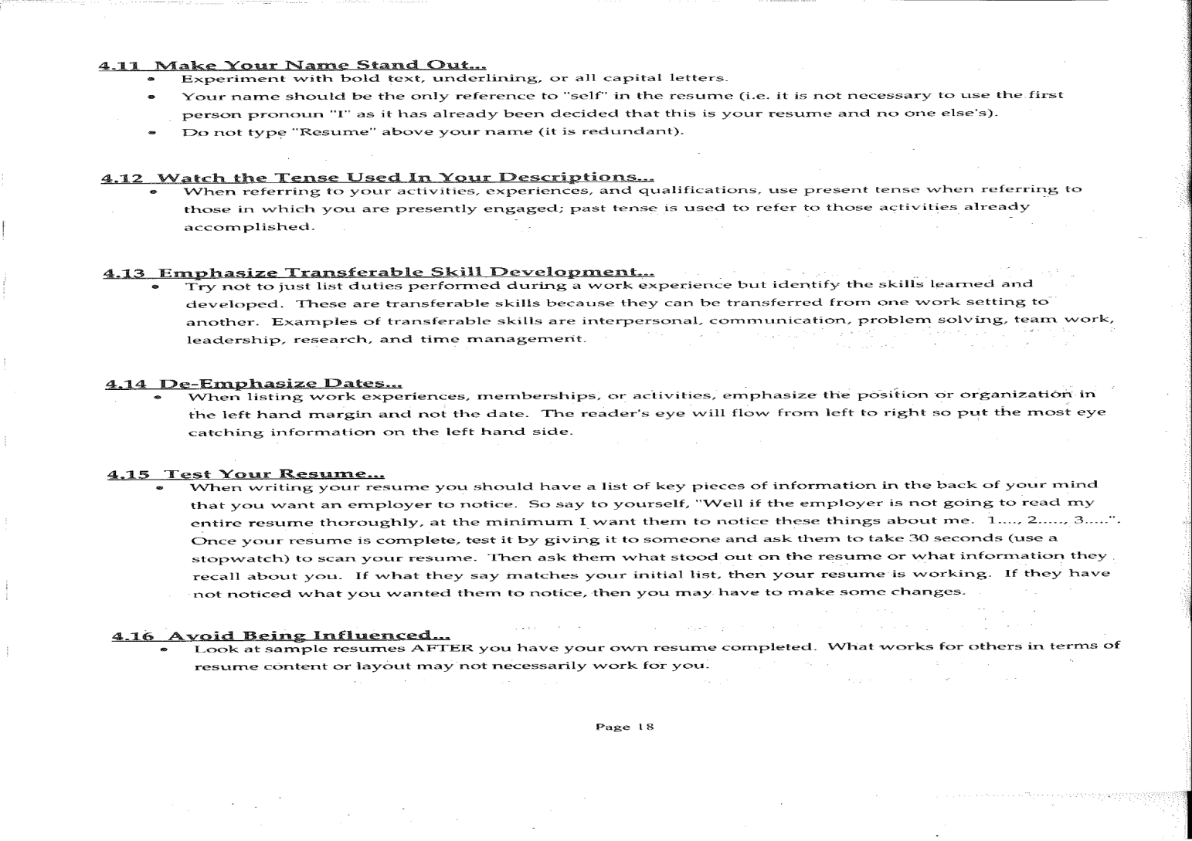

Slide 8
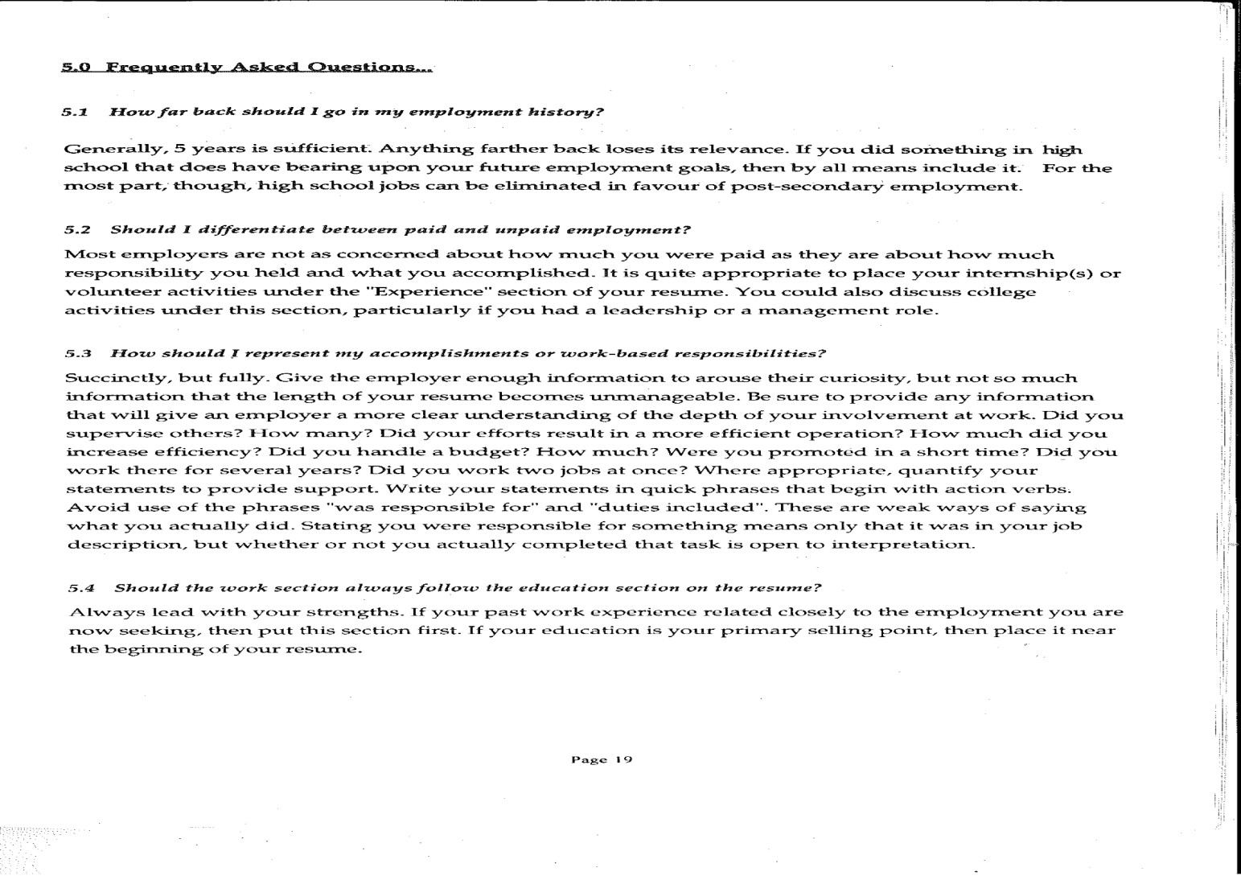

Slide 9
Interesting Links
Job Interviews
https://www.uottawa.ca/career-development-centre/job-search/job-interview
https://www.youtube.com/watch?v=hUhzrIqJ1Jk
https://www.youtube.com/watch?v=mA9eBp93uyg
https://www.livecareer.com/interview/free-video
Preparing for Success:
https://www.youtube.com/watch?v=eIho2S0ZahI&list=PLOGi5-fAu8bHaEGV52hSzl8QeUM4933Xy&index=3
https://www.youtube.com/watch?v=5aH2Ppjpcho&list=PLOGi5-fAu8bHaEGV52hSzl8QeUM4933Xy&index=5
https://www.youtube.com/watch?v=iKHTawgyKWQ
https://www.youtube.com/watch?v=MmfikLimeQ8
https://www.youtube.com/watch?v=02EJ1IdC6tE

Slide 10
Interesting Links
Being Enriched:
https://www.youtube.com/watch?v=36m1o-tM05g
https://www.youtube.com/watch?v=8jPQjjsBbIc&list=PLOGi5-fAu8bHaEGV52hSzl8QeUM4933Xy
https://www.youtube.com/watch?v=1i9kcBHX2Nw
Footnotes:
https://www.livecareer.com/quintessential/job-interview-checklist
https://www.theguardian.com/careers/careers-blog/job-interview-checklist-howto-prepare
https://www.usask.ca/sas/secc

